Slide 1
EXPLORATORY DATA ANALYSIS
Davis David Zindi Africa davisdavid179@gmail.com

Slide 2
CONTENT:
Introduction to EDA
Importance of EDA
Data Types
Python Packages for EDA
List of Graphs
Practical EDA

Slide 3
1.INTRODUCTION TO EDA
Exploratory Data Analysis refers to the critical process of performing initial investigations on data so as to discover patterns, to spot anomalies, to test hypothesis and to check assumptions with the help of summary statistics and graphical representations.
It is a good practice to understand the data first and try to gather as many insights from it.

Slide 4
2. IMPORTANCE OF EDA
Identifying the most important variables/features in your dataset.
Testing a hypothesis or checking assumptions related to the dataset.
To check the quality of data for further processing and cleaning.
Deliver data-driven insights to business stakeholders.
Verify expected relationships actually exist in the data.
To find unexpected structure or insights in the data.

Slide 5
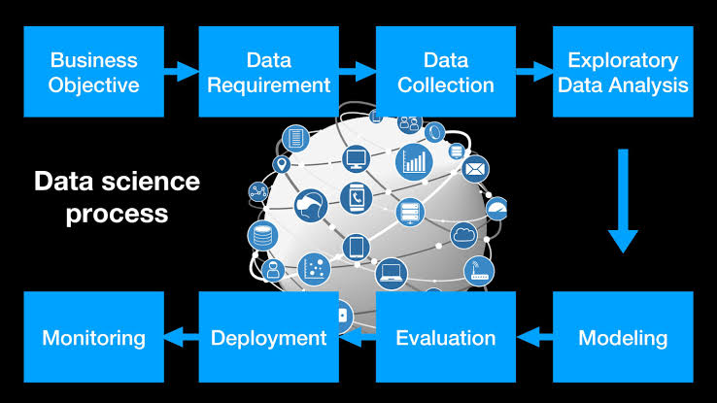

Slide 6
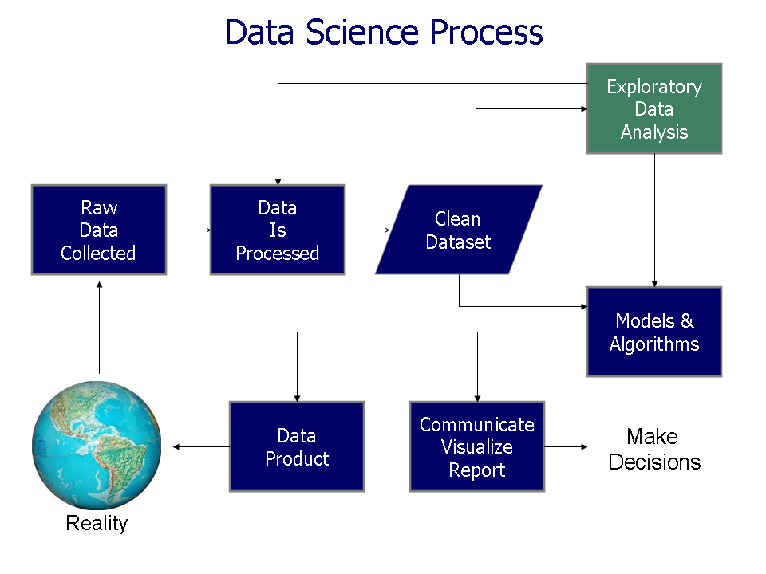

Slide 7
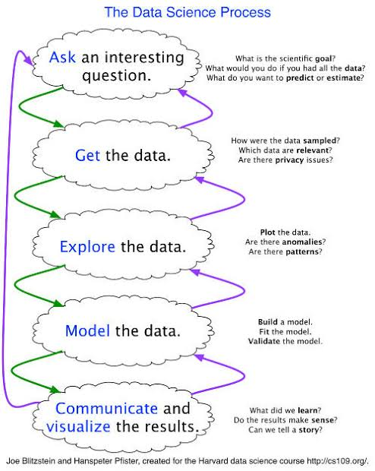

Slide 8
Two Categories of Data
Structured Data types Example: csv file, excel file, database file
Unstructured Data types Examples: text,Images, videos, audio,

Slide 9
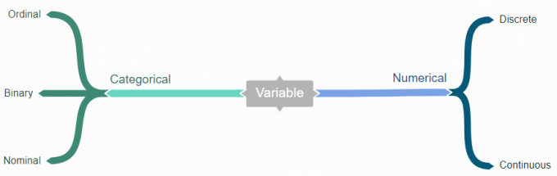
Data Types

Slide 10
Structured Data Types
Categorical - This is any data that isn’t a number.
Ordinal - have a set of order e.g. rating happiness on a scale of 1-10.
Binary - have only two values .e.g. Male or Female
Nominal - no set of order e.g. Countries
Numerical – Data inform of numbers
Continuous - numbers that don’t have a logical end to them e.g heights
Discrete - have a logical end to them e.g. days in the month

Slide 11




Python Packages for EDA

Slide 12
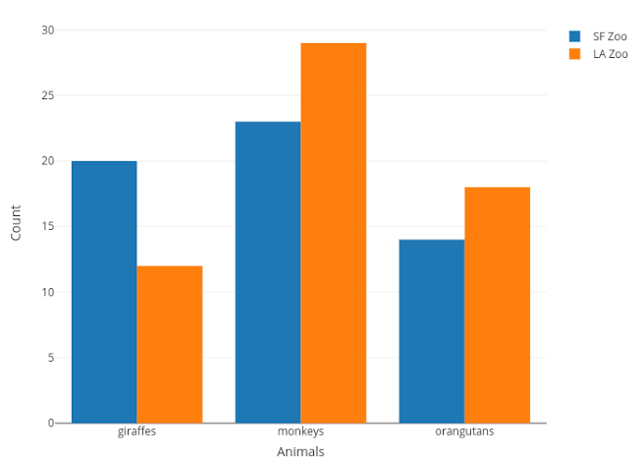
1.Bar Chart

Slide 13
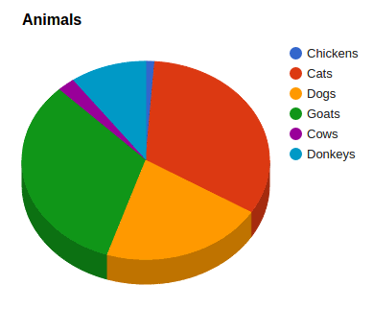
2. Pie Chart

Slide 14
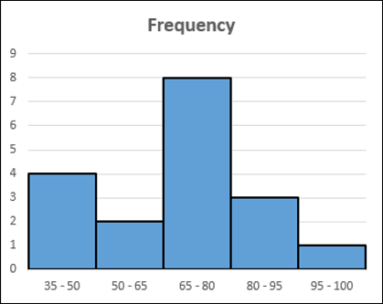
3.Histogram

Slide 15
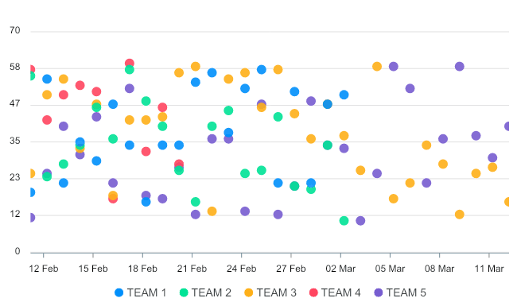
4.Scatter Plot

Slide 16
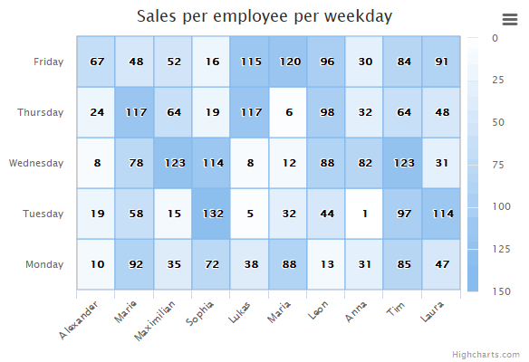
5. Heatmap

Slide 17
6. Box Plot

Slide 18
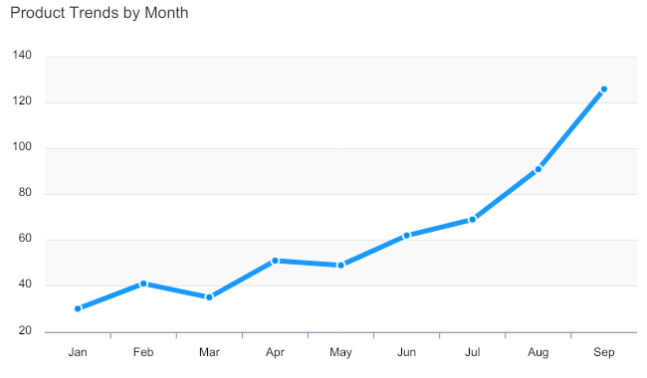
7. Line Plot

Slide 19
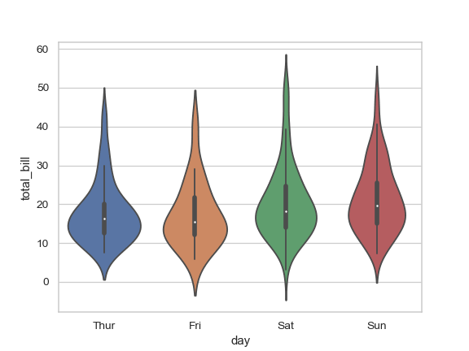
8. Violin Plot

Slide 20
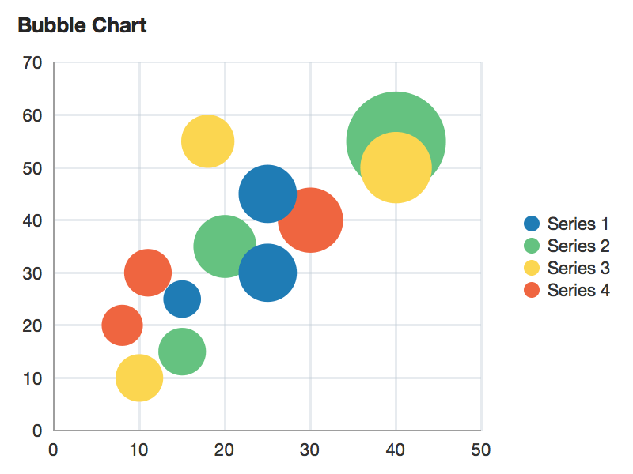
9.Bubble Plot

Slide 21
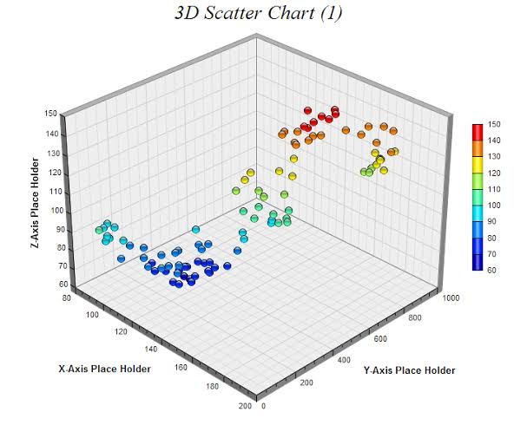
10. 3D Scatter Plot

Slide 22


